Slide 1
Introduction to Data Science
Introduction to Data Science
https://sherbold.github.io/intro-to-data-science

Slide 2
Outline
Introduction to Big Data
Data Science definition
The Skillset of Data Scientists
AI
ML
Summary

Slide 3


What is „Big Data“?!?
Is this really about size?

Slide 4
Naive Definition
Naive definition:
Big data only depends on the data size
1 Gigabyte? 1 Terabyte? 1 Petabyte?
Naive interpretation misses important aspects
Time:
Analyzing 1 Gigabyte of data per day is different from analyzing 1 Gigabyte of data per second
Diversity:
Analyzing spread sheets with numeric data is different from analyzing Web pages that contain a mixture of text and images
Distribution:
Analyzing data from a single source is different from analyzing data from multiple sources

Slide 5


Definition of Big Data
Following Gartner‘s IT Glossary:
Big data is high-volume, high-velocity and/or high-variety information assets that demand cost-effective, innovative forms of information processing that enable enhanced insight, decision making, and process automation.
The three Vs
Volume
Velocity
Variety
Some people actually use 10 Vs to define big data!
Variability
Veracity
Validity
Vulnerability
Volatility
Visualization
Value

Slide 6
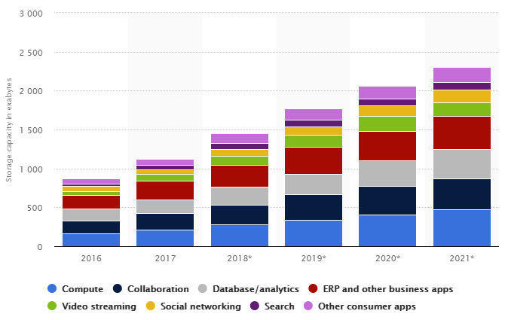
The 3 Vs: Volume
Scale of the data must be „big“
No clear definition
„that demand […] innovative forms of information processing“ (Gartner)
Data center storage worldwide
© Statista 2018

Slide 7

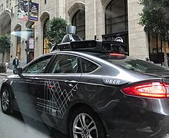

The 3 Vs: Velocity
Speed at which new data is created
Speed at which data must be processed and analyzed
Often close to real-time

Slide 8
The 3 Vs: Variety
Diversity in data types and data sources
Structured
Semi-Structured
Quasi-Structured
Unstructured
Data with defined types and structure
Example: comma separated values
Textual data with parseable pattern
Example: XML files with schema
Textual data with erratic formats that can be formated with effort
Example: Clickstream data
Data that has no inherent structure, often with multiple formats
Example: Web site, videos

Slide 9
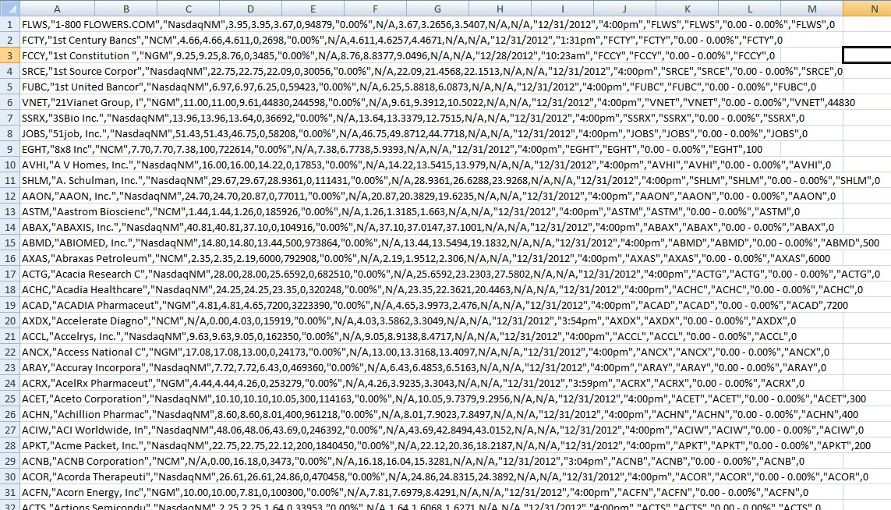
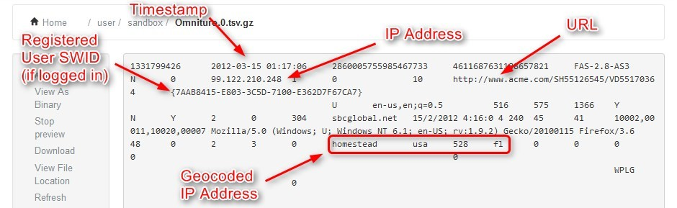
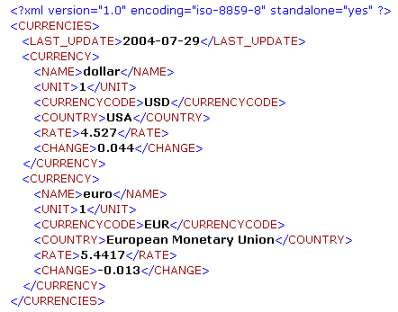
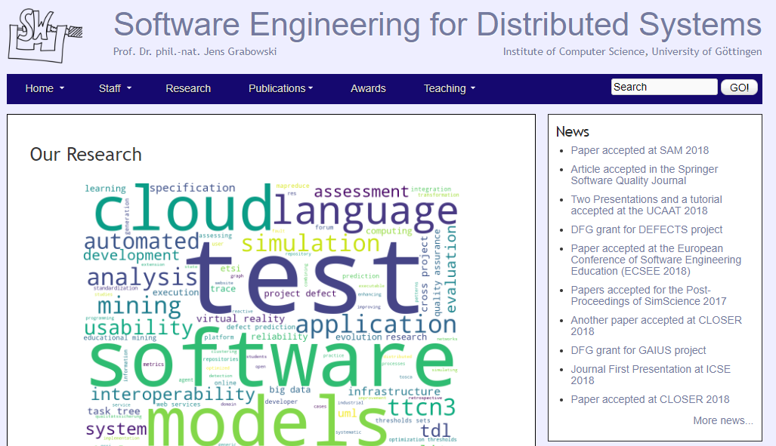
Examples for data types
Structured
Quasi-Structured
Semi-Structured
Unstructured

Slide 10
Outline
Introduction to Big Data
Data Science definition
The Skillset of Data Scientists
AI
ML
Summary

Slide 11
Defining Data Science
Unfortunately, there is no clear definition (yet?)
Goal is the extraction of knowledge from data
Combination of techniques from different disciplines
Scientific principles guide the data analysis

Slide 12

What is „Data Science“?!?
Tools? Big Data? Machine Learning?

Slide 13
Mathematical Aspects
Computational Geometry
Optimization
Stochastics
Machine Learning
Scientific Computing

Slide 14
Computer Science Aspects
Data Structures and Algorithms
Databases
Distributed Computing
Software Engineering
Artificial Intelligence
Machine Learning

Slide 15
Statistical Aspects
Linear Models
Statistical Tests
Inference
Time Series Analysis
Machine Learning

Slide 16
Applications
Intelligent Systems
Robotics
Marketing
Social Networks
Medicine
Autonomous Driving

Slide 17
Outline
Introduction to Big Data
Data Science definition
The Skillset of Data Scientists
AI
ML
Summary

Slide 18
What are Data Scientists?
Not computer scientists
But should know about databases, data structures, algorithms, etc.
Not mathematicians
But should know about optimization, stochastics, etc.
Not statisticians
But should know about regression, statistical tests, etc.
Not domain experts
But must work together with them

Slide 19
Skills of Data Scientists
Data Scientists
Quantitative
Skeptical
Collaborative
Technical
Programming
Infrastructures
Maths
Algorithms
Create hypotheses, but be skeptical about them
Teamwork
Communication skills
Statistics
A bit of everything
… but actually as much as possible of everything

Slide 20
Different types of Data Scientists
Data Analyzer
Analyzing data
Platform Builder
Collect data and create infrastructures
Moonlighters (50%/20%)
„Spare time“ data scientists
Insight Actors
Use the outcome and act on insights.
According to Microsoft Research:
Polymath
„Do it all“
Data Evangelist
Data analysis, disseminating and acting on insights
Data Preparer
Querying existing data, preparing data for analysis
Data Shapers
Analyzing and preparing data
Miyung Kim, Thomas Zimmermann, Robert DeLine, Andrew Begel: Data Scientists in Software Teams: State of the Art and Challenges, IEEE Transactions on Software Engineering (Online First)

Slide 21
Data Science Definition
Data science is a multidisciplinary field that uses scientific methods, algorithms, processes, and systems to extract valuable insights and knowledge from structured and unstructured data.
It combines elements of statistics, computer science, domain knowledge, and data visualization to analyze large and complex datasets, uncover patterns, make predictions, and inform decision-making.

Slide 22
Data Science vs. Business Intelligence
Business Intelligence (Gartner IT Glossary)
[…] best practices that enable access to and analysis of information to improve and optimize decisions and performance.
Depth of Insights
 | Business Intelligence | Data Science
Techniques | Dashboards, alerts, queries | Optimization, predictive modelling, forecasting
Data Types | Structured, data warehouses | Any kind, often unstructured
Common questions | What happened…? How much did…? When did…? | What if…? What will…? How can we…?
High
Data Science
Business Intelligence
Low
Past
Present
Future
Time

Slide 23
Dashboard examples

Slide 24
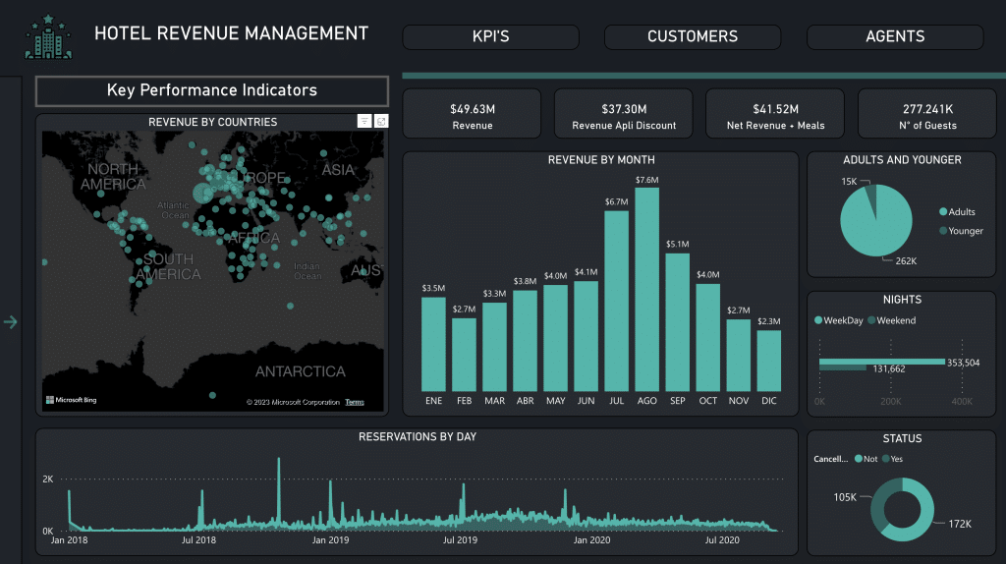

Slide 25
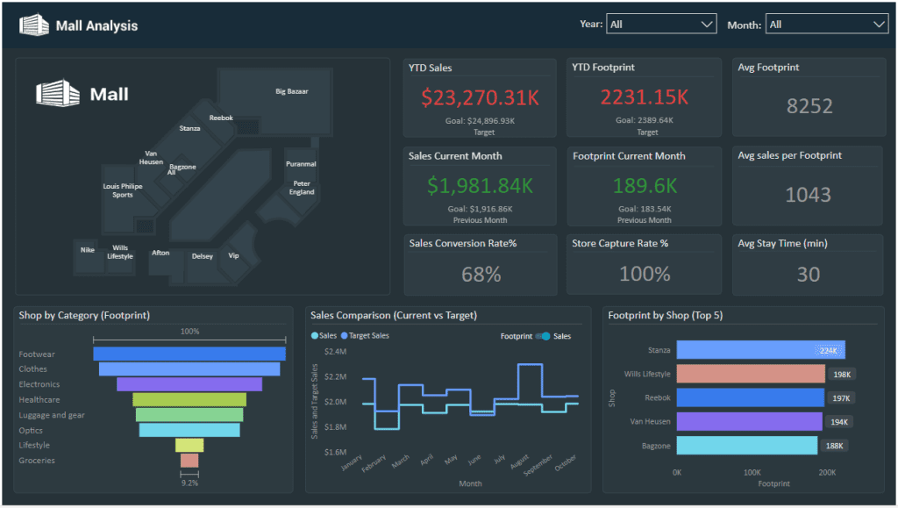

Slide 26
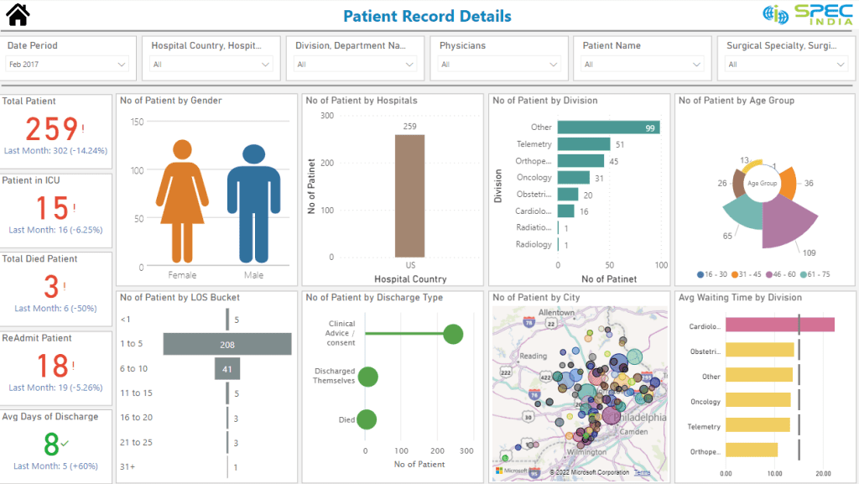

Slide 27
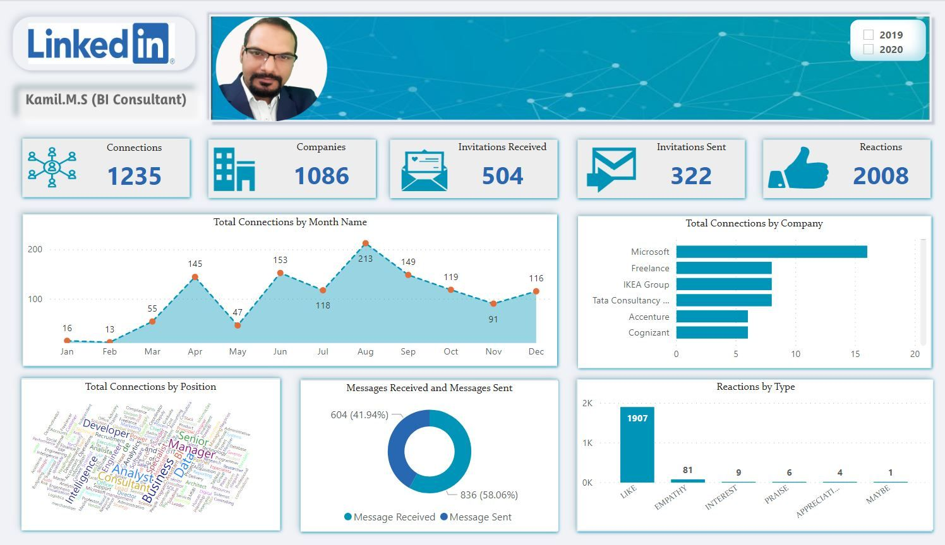

Slide 28
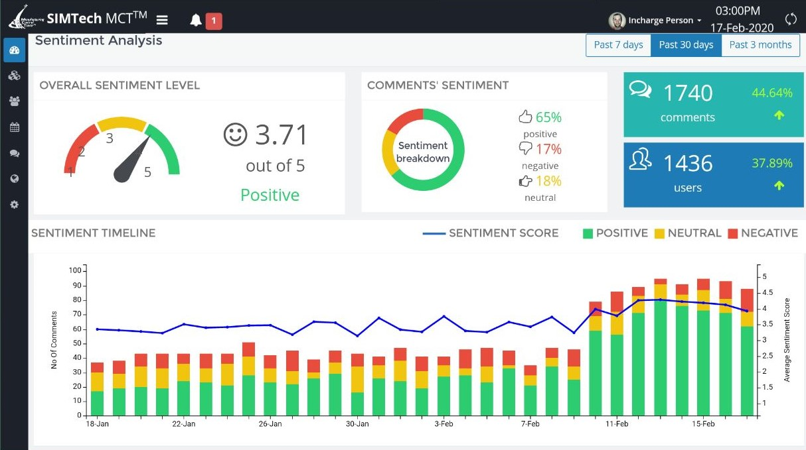

Slide 29
AI definition
Artificial Intelligence (AI) refers to the simulation of human intelligence in machines or computer systems.
It involves the development of algorithms, software, and hardware that enable computers to perform tasks that typically require human intelligence, such as understanding natural language, recognizing patterns, making decisions, and solving problems.

Slide 30








Slide 31
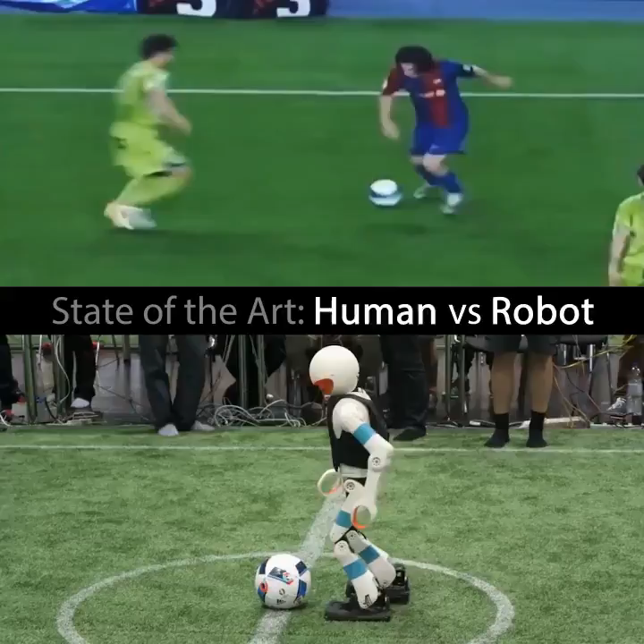
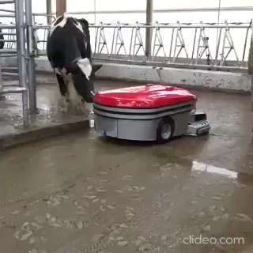

Slide 32
Types of AI
Narrow AI (Weak AI): This type of AI is designed for specific tasks or domains. It excels at performing functions, such as voice recognition, image classification, or playing board games like chess or Go. Narrow AI systems do not possess general intelligence or consciousness and are trained for specific applications.
General AI (Strong AI): General AI represents machines or systems that possess human-like intelligence, including the ability to understand, learn, and apply knowledge across a wide range of tasks and domains. Achieving general AI is a long-term goal of AI research and development and is yet to be realized.

Slide 33

Alexa helps to solve assignments ☺

Slide 34
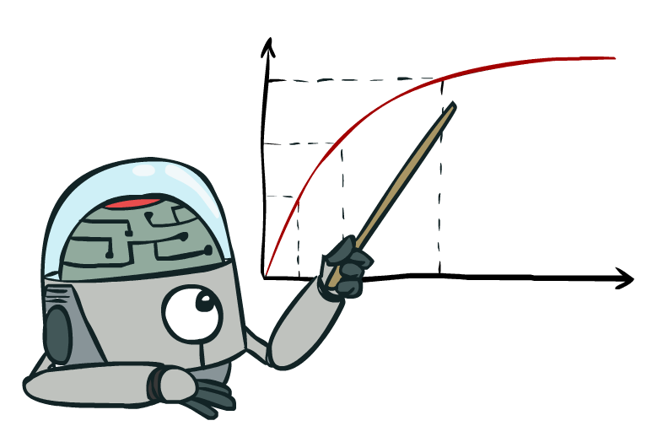
Maximize Your
Expected Utility
Notes:
Distill course to maximize expected utility

Slide 35
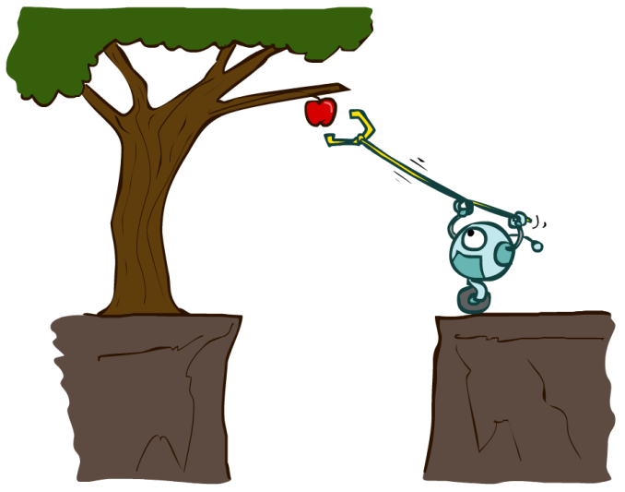
Designing Rational Agents
An agent is an entity that perceives and acts.
A rational agent selects actions that maximize its (expected) utility.
Characteristics of the percepts, environment, and action space dictate techniques for selecting rational actions
Sensors
Agent
Percepts
Environment
?
Actuators
Actions

Slide 36
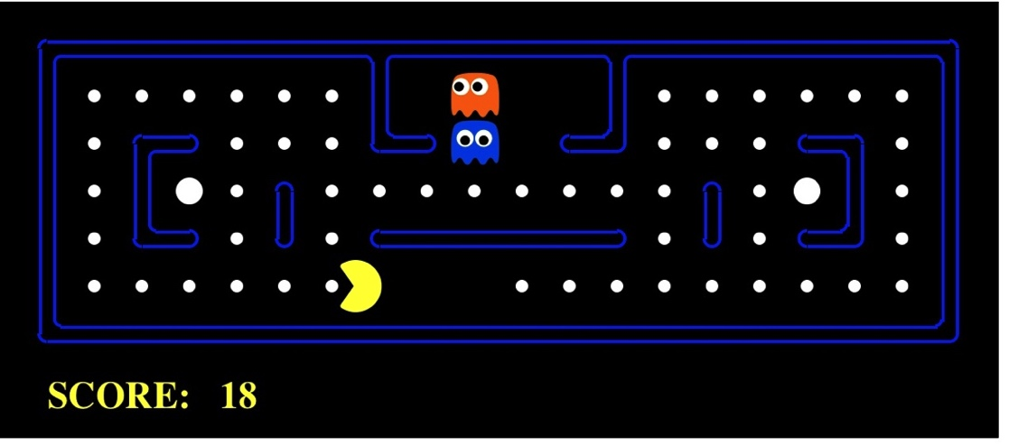
Pac-Man as an Agent
Agent
Environment
Sensors
Percepts
?
Actuators
Actions
Pac-Man is a registered trademark of Namco-Bandai Games, used here for educational purposes
Demo1: pacman-l1.mp4

Slide 37
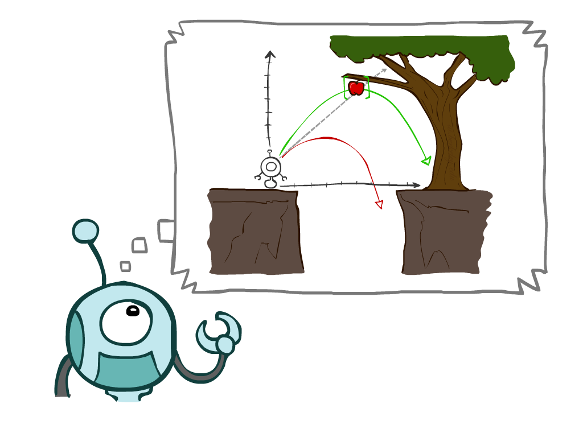

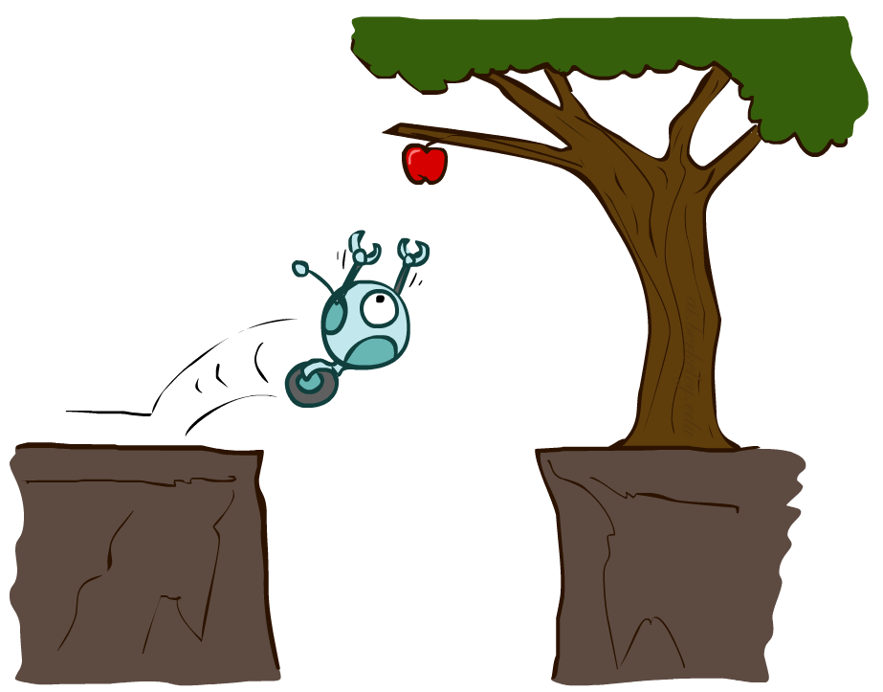

Search
How do we formulate a search problem?

Slide 38
Machine Learning (ML) definition
Machine Learning (ML) is a subset of artificial intelligence (AI) that focuses on the development of algorithms and statistical models that enable computer systems to improve their performance on a specific task through learning from data, without being explicitly programmed.
ML allows computers to automatically discover patterns, make predictions, or take actions based on past experiences or examples.

Slide 39
ML vs Traditional Programming
Aspect | Machine Learning (ML) | Traditional Programming
Purpose | Learning from data to make predictions, recognize patterns, and automate decision-making. | Executing predefined instructions and algorithms to achieve specific tasks.
Data-driven | Relies on data for training and learning patterns. | Not data-driven; instructions are explicitly programmed.
Flexibility | Adaptable to changing data and can improve with more examples. | Less adaptable and requires manual code changes for modifications.
Problem Complexity | Suited for complex problems with large datasets or uncertain environments. | Effective for well-defined, deterministic tasks.
Expertise Required | Requires knowledge of data preprocessing, algorithm selection, and model tuning. | Requires expertise in programming languages, algorithms, and problem-solving.
Maintenance | May require periodic retraining and adjustment as data changes. | Maintenance involves debugging, updating, and code optimization.

Slide 40
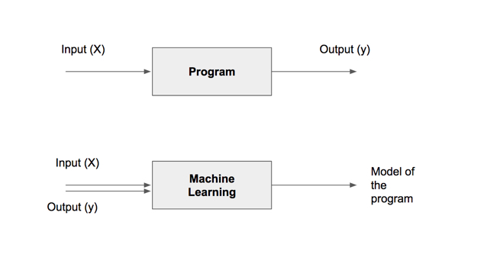
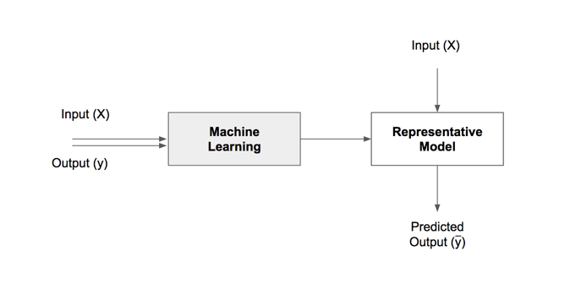
ML models vs programs

Slide 41
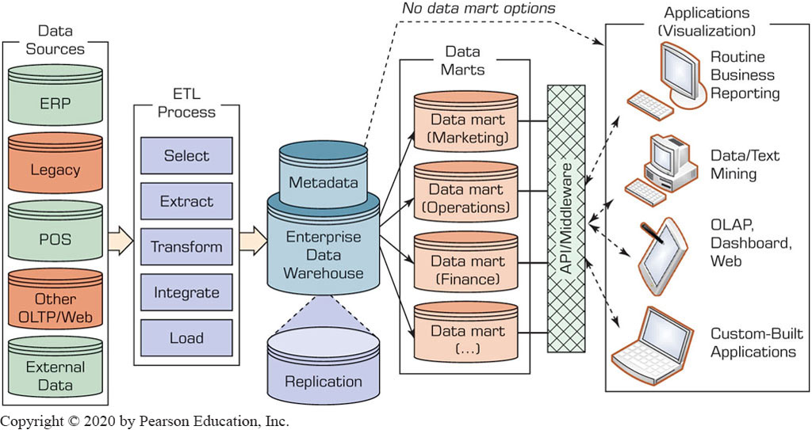
Data Pipeline

Slide 42
Some Data Science Tasks
Tasks | Description | Algorithms | Examples
Classification | Predict if a data point belongs to one of predefined classes. The prediction will be based on learning from known data set. | Decision Trees, Neural networks, Bayesian models, Induction rules, K nearest neighbors | Assigning voters into known buckets by political parties eg: soccer moms. Bucketing new customers into one of known customer groups.
Regression | Predict the numeric target label of a data point. The prediction will be based on learning from known data set. | Linear regression, Logistic regression | Predicting unemployment rate for next year. Estimating insurance premium.
Clustering | Identify natural clusters within the data set based on inherit properties within the data set. | K means, density-based clustering - DBSCAN | Finding customer segments in a company based on transaction, web and customer call data.
Association analysis | Identify relationships within an itemset based on transaction data. | FP Growth, Apriori | Find cross selling opportunities for a retailor based on transaction purchase history.

Slide 43
Summary
Big data has a high volume, velocity, and variety
Different data structures
Structured, semi-structured, quasi-structured, unstructured
Data science is a very diverse discipline
Maths, computer science, statistics, applications
→ Data scientists require a diverse skillset

